Slide 1
760 Series Long-Term Trial
By: Jack Magalsky, Aaron Gallego, Kevin Maehlmann

Slide 2
Modeling Sub Questions
 | Which wheat varieties can be classified by HIGH/LOW inoculum and take all tolerance?
 | What weeks do environmental features exert the greatest influence on take all intensity (percentage of roots infected)?
Classification
Environmental Effects

Slide 3
Modeling Goals
By evaluating these questions, the Agricultural industry can benefit by…
Improving management strategies
Linking environmental patterns to disease severity, supporting more accurate rotation planning, fungicide timing decisions, and early season risk assessments.
Dictating plant selection choices
Classifying wheat varieties by inoculum build up potential and take all resistance, providing breeders and growers with backed guidance on which varieties are best suited for low risk rotations or for fields with a history of take all.

Slide 4
Data Preparation - Long Term
Datasets
Feature Engineering
Cleaning
Multi-year Rothamsted wheat and take all buildup datasets (2016–2020) for 760 series; data was concatenated and loaded into Python.
Daily environmental measurements dataset filtered between 2016-2020.
Plant height data merged with take all buildup dataset on block, replicate, and variety type.
Divided total plants/roots infected by their total to create standardized rates between observations.
Created inoculum labels (“HIGH”, “LOW”) for plant varieties.
Encoded variety types between 0-5 for classification and simple vector regression.
Data already pre-cleaned by previous student group.
Aggregated daily environmental measurements into weekly means and sums before model fitting.
Removed series with unrealistic biological values (e.g., infection >100%, negative plant counts, missing replicates).

Slide 5
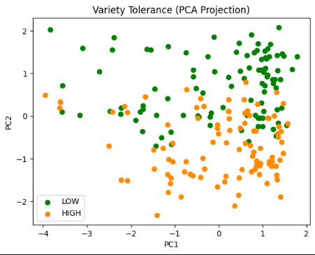
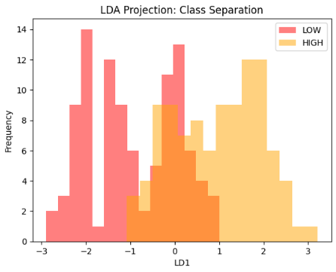
Classification Model Process
PCA HIGH vs. LOW Inoculum
LDA Feature Selection
Features
(PC1) Root Infected Pct
(PC1) Plant Infected Pct
(PC2) Plant Height
Col | PC1 | PC2
Height | 0.07156 | 0.99699
Root Pct | 0.70650 | -0.02948
Plant Pct | 0.70454 | -0.07172
Model Preprocessing
CLASS
PCA
LDA
SVM

Slide 6
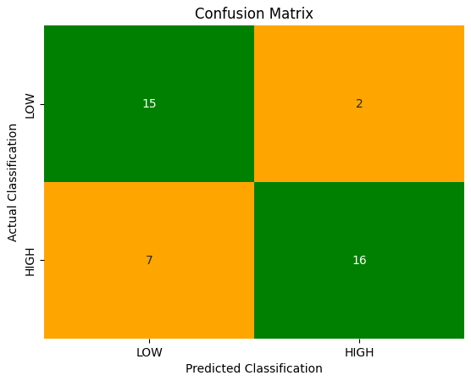
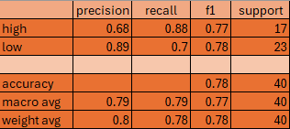
SVM Performance
Training Varieties
low
Cadenza | LOW
Hereward | HIGH
high
The report shows that the model displays a balanced performance across inoculum classes. Both classes show strong recall and precision. Higher accuracy with LOW classification.
Overall Test Accuracy: 77.5%
Train Data
All data between 2016-2020, split 80/20 using random sampling.
Data standardized through scaler package
160 unique observations.
Test Data
Data between 2016-2020 from same dataset.
40 unique observations.

Slide 7
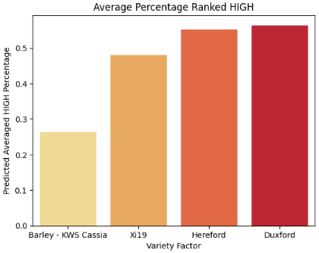
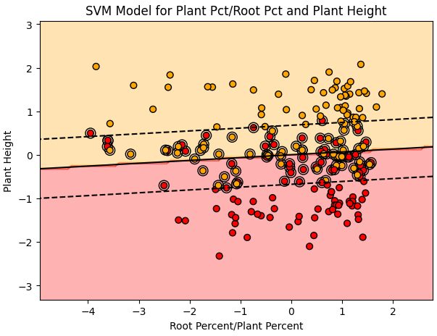
SVM Model Classification
LOW
HIGH
Inoculum Classification
VARIETY | INOCULUM
Cadenza | LOW
Hereward | HIGH
Barley | LOW
Duxford | MEDIUM
Hereford | MEDIUM
Xi19 | LOW/MED
Averaged over 200 random states
The SVM decision boundary shows that varieties with higher root infection values tend to cluster toward the HIGH inoculum class, while those with lower infection rates fall into the LOW class.
Points inside the margin indicate borderline biological behavior. These varieties may require monitoring or cautious placement in high-risk fields.

Slide 8
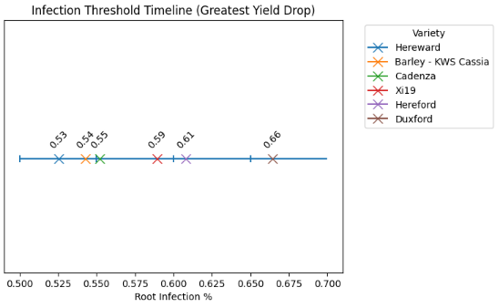
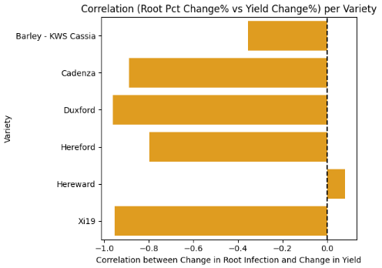
Yield Thresholding - Slope
Estimate of root infection percentage when yield experiences greatest decrease for each variety.
No significant observable difference in correlation of yield between HIGH and LOW inoculum varieties by correlation between 2016-2019.
Hereward displays the lowest threshold at 53% root infection; loses yield the earliest.
Duxford is the most tolerant, can withstand greater infection build up before collapse at 66%.

Slide 9
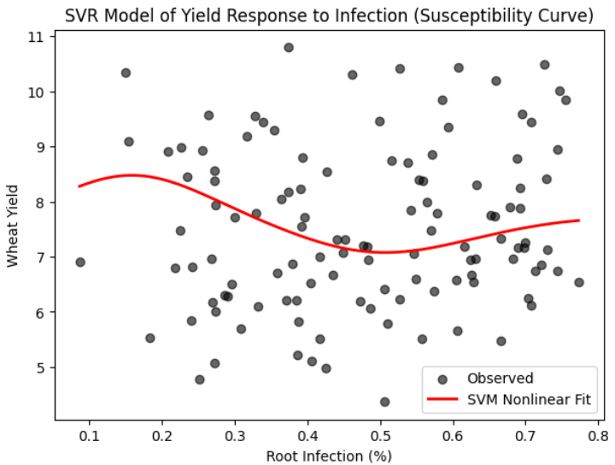
Yield Thresholding - SVR
On average, yield loss takes greatest effect mid-infection range, but doesn’t experience any further significant loss with increasing root infection
VARIETY | RESIDUAL
Cadenza | 0.262002
Hereward | -1.124031
Barley | 0.000091
Duxford | 0.691340
Hereford | 0.807812
Xi19 | -0.589293

Slide 10
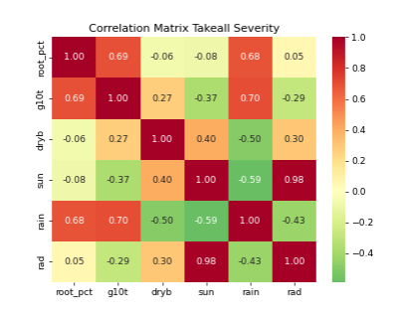
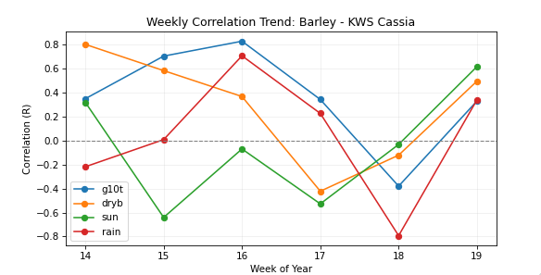
Environmental Influence
Correlations between environmental features and take all severity. Measured by aggregating feature sums by 2016-2019 and Weeks 1-35. Rainfall is sliding window dataset.
Correlation map for 2016-2020 between selected weekly averaged features and averaged root infected percentage.
Example: Weeks 14-19 for Barley.

Slide 11
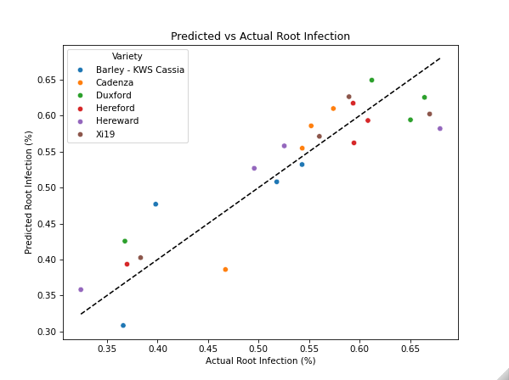
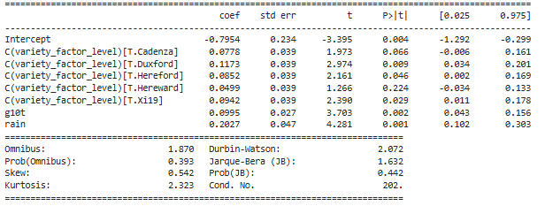
Environmental - Regression
RESULTS TABLE: Best 5-Week Interval
Start Week | 14
End Week | 19
AIC | -64.187795
R^2 | 0.814244
Root_pct ∼ 0.0166(g10t) + 0.0338(rain) + C(variety_type)

Slide 12
Summary and Results
CLASSIFICATION
Across all trial-year combinations, wheat varieties were consistent in the differences in take all severity. Varieties with LOW inoculum build up (Xi19 and Barley) also displayed lower level root infection; MEDIUM/HIGH inoculum (Duxford and Hereford) varieties displayed greater infection intensity.
Threshold analysis using slope-change along take all root infection -> wheat yield showed that varieties experienced a sharp decline in yield at different intensities. Hereward had the earliest decline at 53% and Duxford had the latest at 66%.
Despite the LOW/HIGH inoculum classification, it appears it isn’t consistent with yield susceptibility to take all. LOW varieties displayed a comparable yield decline correlation to severity as HIGH.

Slide 13
Summary and Results
ENVIRONMENTAL FEATURES
Averaged soil temperature and rainfall displayed the greatest positive correlation on take all root intensity between 2016-2020.
Mid season windows, like weeks 14-19, show greater correlation between take all intensity and the stated features than early or later weeks.
  During midseason, root systems are deeply developed with increased surface area. Soil temperatures begin to elevate inoculum leaves its dormant state. Root biomass increases soil aggregation and moisture retention.
  Environmental influence declines later season due to infection saturation and reduced root growth, explaining why weekly correlations weaken after week 19.

Slide 14
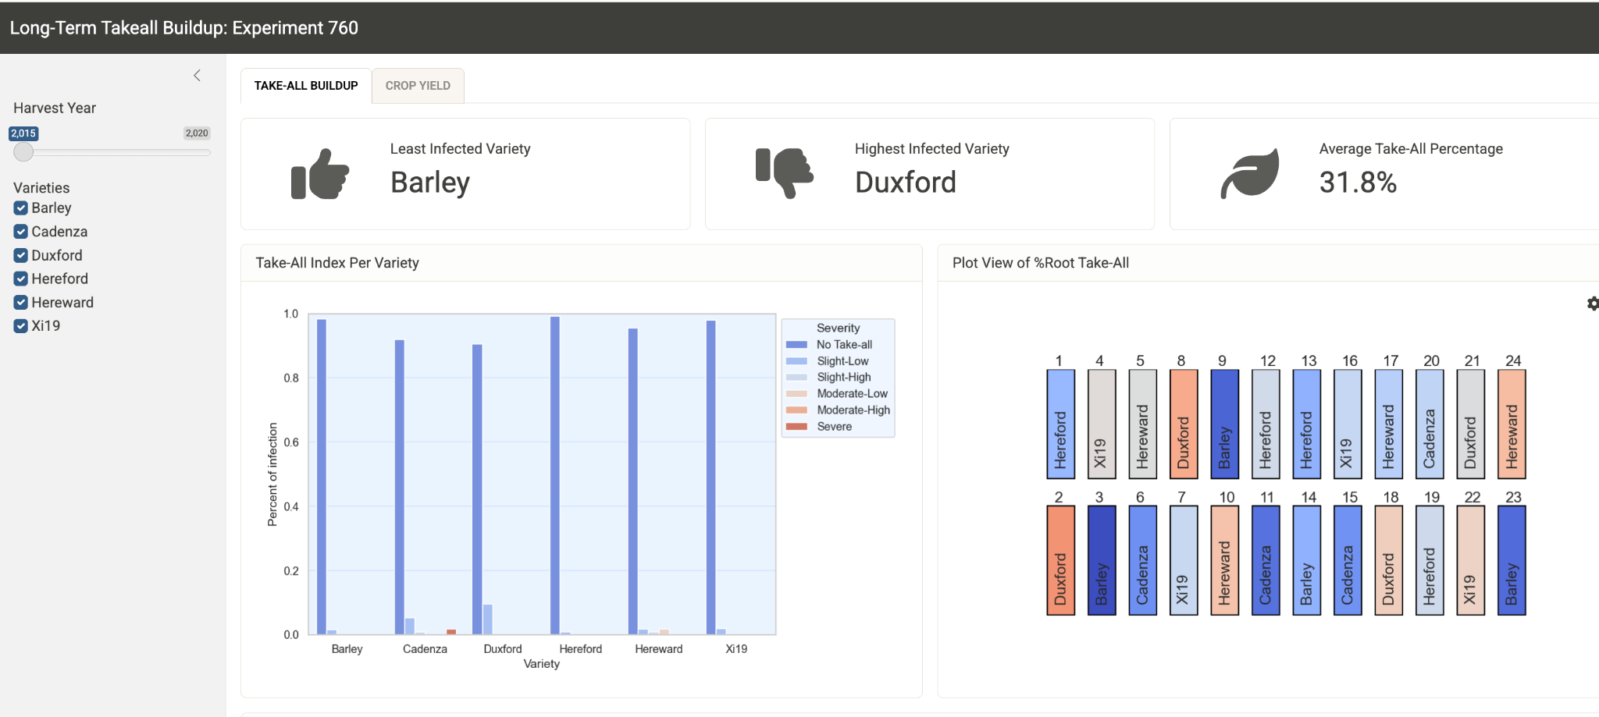
Long-Term Take-All Shiny Dashboard

Slide 15
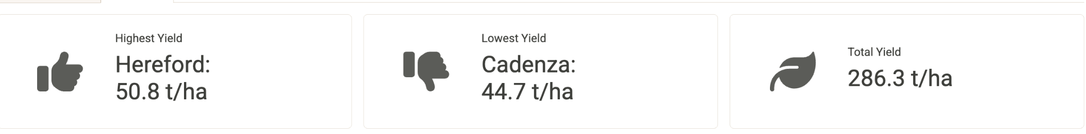
Long-Term Take-All Shiny Dashboard
Features:
Accurate plot view of infection/yield
Graphs on take-all percentage/severity and yield
Yearly summaries on:
Best/Worst performing varieties
Total take-all/yield
Selection on:
Year
Wheat Variety

Slide 16
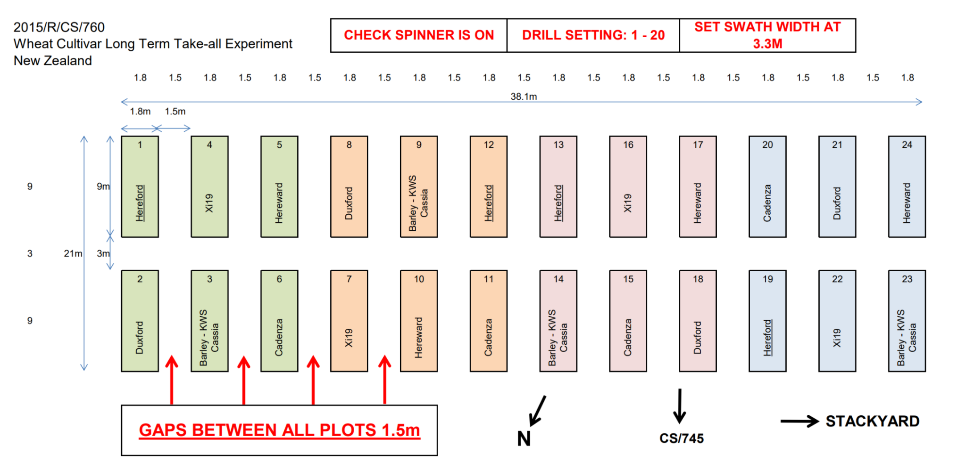
Dashboard Demonstration

Slide 17
Long-Term Take-All Shiny Dashboard
Observations:
Subplot 24 (Hereward) developed immunity in year 1
Cadenza has strong resistance in year 2
Cadenza makes the highest recovery in yield
Can be expanded to:
Short-term, including weather data
Long-term experiments 770, etc.

